Slide 1
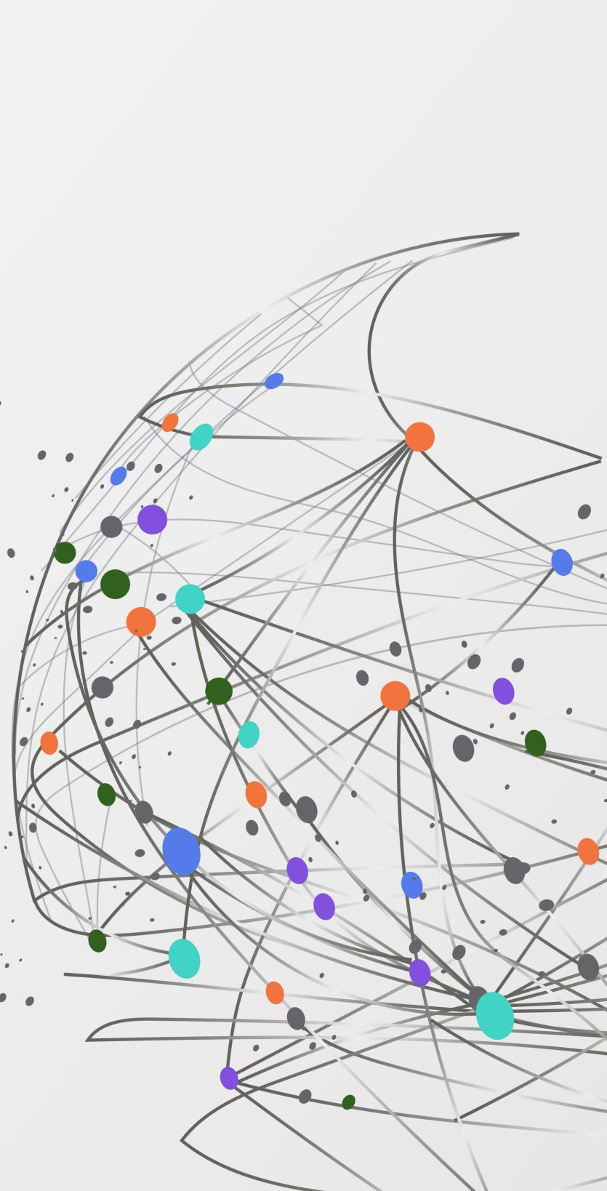
The .NET ABC of things you pretend to know about
Nico Vermeir

Slide 2
“Hey you know <Insert technical term here> right?”

Slide 3

Nice to meet you!
.NET Architect @ Inetum Belgium
Microsoft MVP since 2014
Community leader / member
Conference Speaker
BlueSky @nicovermeir.bsky.social

Slide 4
Topics
AppSettings
.NET (naming, architecture, …)
Records / Structs / Classes
Trimming
Garbage Collection
AOT / JIT
Docker
OAuth / OIDC
SQL Transactions
SQL Indexes
OpenTelemetry

Slide 5
How this session works
You decide the content
We’ll see how far we get

Slide 6
.NET

Slide 7
Naming is hard..
.NET Framework: .NET 1.0 - .NET 4.8
.NET: .NET 5 - .NET 9
.NET Core: old name of new .NET
.NET Standard: API contract of .NET APIs

Slide 8
.NET Architecture
WPF
ASP.NET Core
MAUI
WinForms
WinUI 3
Base Class Library (BCL)
Compilers
Languages
Runtimes

Slide 9
Operating System layers
Process Management
CPU Scheduling
Memory Management
I/O Buffer
User Programs
Direct access with C++

Slide 10
Operating System layers
Process Management
CPU Scheduling
Memory Management
I/O Buffer
User Programs
Applications with C#
Abstracted by .NET

Slide 11
Records / Structs / Classes

Slide 12
Struct
Value types
Ideal for immutable, small, data centric types
public struct Coords
{
public Coords(double x, double y)
{
X = x;
Y = y;
}
public double X { get; }
public double Y { get; }
public override string ToString() => $"({X}, {Y})";
}
Notes:
Not immutable by default, but prefer to it for immutable types
No inheritance, but interfaces work

Slide 13
Struct
Value types
Ideal for immutable, small, data centric types
public readonly struct Coords
{
public Coords(double x, double y)
{
X = x;
Y = y;
}
public double X { get; }
public double Y { get; }
public override string ToString() => $"({X}, {Y})";
}
Notes:
Better to use readonly structs to enforce immutable behavior

Slide 14
Struct – With keyword
var p1 = new Coords(0, 0);
Console.WriteLine(p1); // output: (0, 0)
var p2 = p1 with { X = 3 };
Console.WriteLine(p2); // output: (3, 0)
public struct Coords
{
public Coords(double x, double y)
{
X = x;
Y = y;
}
public double X { get; }
public double Y { get; }
public override string ToString() => $"({X}, {Y})";
}
Notes:
Not immutable by default, but prefer to it for immutable types

Slide 15
Records
Record => reference type
Record struct => value type
Immutable by default, can be made mutable
public record Foo(string Name, string Status, DateTimeOffset ModifiedDate);
public record struct Foo(string Name, string Status, DateTimeOffset ModifiedDate);

Slide 16
Records vs classes vs structs
Can it be a value type?
struct
Does it look to be immutable?
Record
Class

Slide 17
Trimming

Slide 18
Trimming
Reduces size in self-contained applications
<PropertyGroup>
<PublishTrimmed>true</PublishTrimmed>
</PropertyGroup>

Slide 19
Before Trimming
Module
Module 1
MyApp
Module
Module 2
Module
Module

Slide 20
After Trimming
Module 1
MyApp
Module

Slide 21
Trimming
Watch out for:
Reflection
Dynamic assembly loading
Dependency Injection
Notes:
Reflection: json.net / configurationmanager

Slide 22
Garbage Collection

Slide 23
Memory allocation
public void Foo() { int x = 3; int y = 4;
MyClass bar = new(); }

Slide 24
Memory allocation
Managed Memory
public void Foo() { int x = 3; int y = 4;
MyClass bar = new(); }
Stack
Heap

Slide 25
Memory allocation
Managed Memory
public void Foo() { int x = 3; int y = 4;
MyClass bar = new(); }
Stack
Heap
x = 3

Slide 26
Memory allocation
Managed Memory
public void Foo() { int x = 3; int y = 4;
MyClass bar = new(); }
Stack
Heap
x = 3
y = 4

Slide 27
Memory allocation
Managed Memory
public void Foo() { int x = 3; int y = 4;
MyClass bar = new(); }
Stack
Heap
x = 3
y = 4
bar

Slide 28
Memory allocation
Managed Memory
public void Foo() { int x = 3; int y = 4;
MyClass bar = new(); }
Stack
Heap
x = 3
y = 4
bar

Slide 29
Garbage Collection
Managed Heap
Object Heap
Large Object Heap
Notes:
Large object heap for objects > 85000 bytes

Slide 30
GC Phases
Marking Phase
1
Relocating Phase
2
Compacting Phase
3
Notes:
Marking Phase: The garbage collector creates a list of all live objects by following references from root objects. Objects not on this list are considered for deletion
Relocating Phase: References of live objects are updated to point to their new locations in memory
Compacting Phase: The heap is compacted by moving live objects together and freeing up space occupied by dead objects

Slide 31
GC Generations
Generation 0
Generation 1
Generation 2
Notes:
Generation 0: Contains short-lived objects, such as temporary variables. Garbage collection occurs most frequently in this generation
Generation 1: Acts as a buffer between short-lived and long-lived objects. Objects that survive Generation 0 collections are promoted to Generation 1
Generation 2: Contains long-lived objects, such as static data. Objects that survive Generation 1 collections are promoted to Generation 2

Slide 32
When?
The system has low physical memory
The memory that's used by allocated objects on the managed heap surpasses an acceptable threshold
The GC.Collect method is called

Slide 33
Ahead-of-time / Just-in-time

Slide 34
Just-In-Time compilation
C#
IL
Native

Slide 35
Ahead-Of-Time compilation
.NET with Native AOT
C#
Native
Notes:
No reflection
Better performance vs longer builds
Single exe, no dll
smaller
Limited debugging
Only for deploy, not debug
Can’t compile for linux on windows

Slide 36
Enable AOT Support
<PropertyGroup>
<PublishAot>true</PublishAot>
</PropertyGroup>

Slide 37
Docker

Slide 38
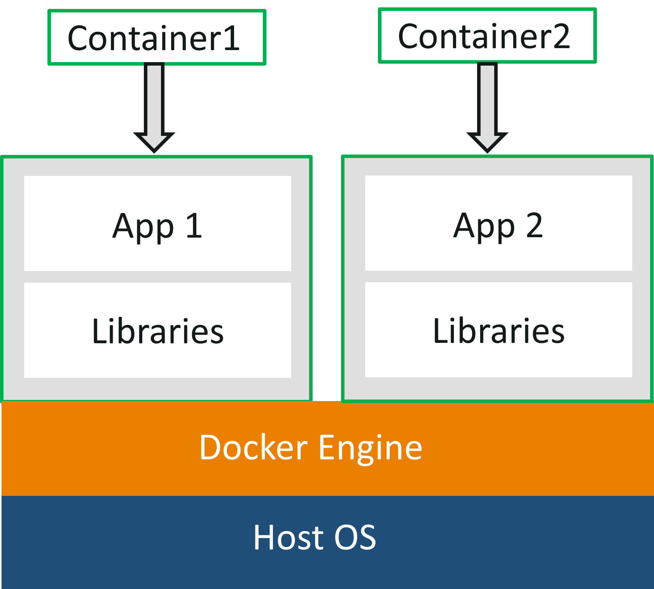
Docker

Slide 39
Docker
MyApp

Slide 40

Docker
> Docker build . -t MyApp:1.0
MyApp
Dependency1
Dependency2
Docker Image
Dockerfile

Slide 41
Docker
> Docker image push MyApp:1.0
Container Registry
MyApp
Dependency1
Some Other app:2.3
Dependency2
MyApp:1.0
Dockerfile

Slide 42
Docker
> Docker run MyApp:1.0
Container Registry
Docker Host
Some Other app:2.3
Running container
MyApp:1.0

Slide 43
Docker
> Docker run MyApp:1.0
Container Registry
Docker Host
Some Other app:2.3
Running container
MyApp:1.0

Slide 44
Docker
> Docker run MyApp:1.0
Container Registry
Docker Host
Some Other app:2.3
Running container
MyApp:1.0
MyApp:1.0

Slide 45
Docker
Pack application > docker build .
Run application as container > docker run <image name>
Tag image > docker image tag <image name>:latest <new tag name>:1.0

Slide 46
Docker Demo

Slide 47
OAuth / OIDC

Slide 48
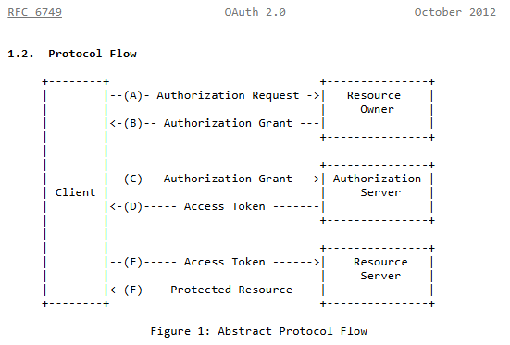
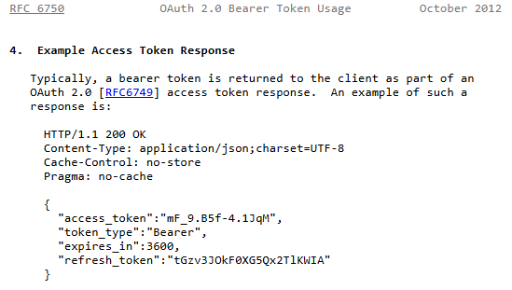
OAuth 2.0
Framework described by RFC 6749 and RFC 6750
Describes authentication and authorization protocols
https://www.rfc-editor.org/rfc/rfc6749.html
https://www.rfc-editor.org/rfc/rfc6750.html

Slide 49
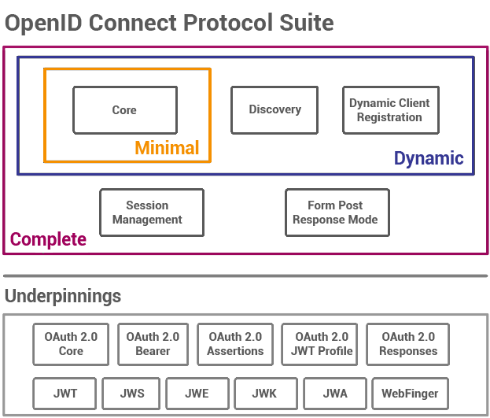
OpenID Connect
Interoperable authentication protocol based on the OAuth 2.0 framework
Web, Mobile, JavaScript
https://openid.net/developers/how-connect-works/

Slide 50
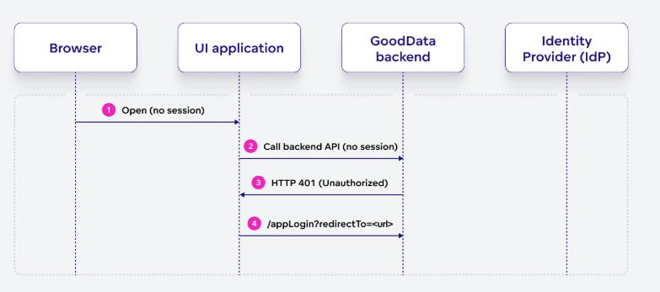
Flow

Slide 51
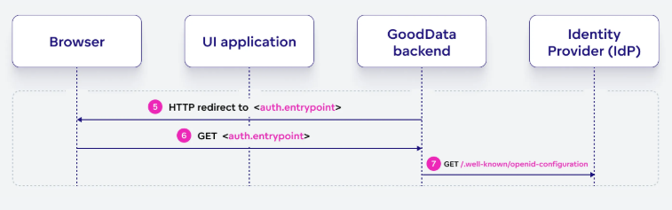
Initialize Authentication

Slide 52
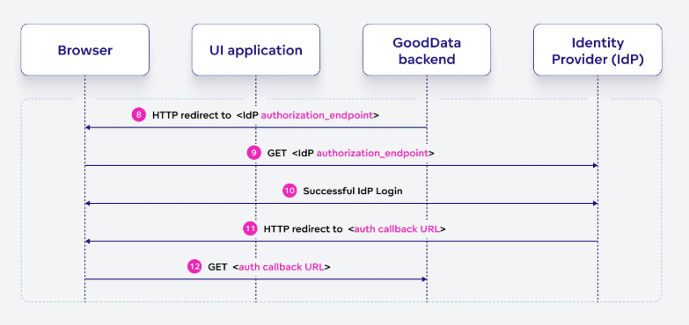
Authenticate

Slide 53
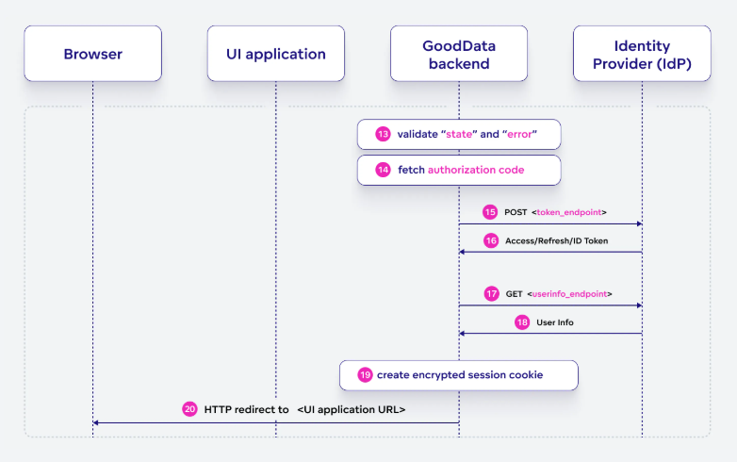
Validation

Slide 54
SQL Transactions

Slide 55
SQL Transactions
ACID
Atomic
Consistent
Isolated
Durable
Notes:
Atomicity: The outcome of a transaction can either be completely successful or completely unsuccessful
Consistency: Transactions maintain integrity restrictions by moving the database from one valid state to another.
Isolation: Concurrent transactions are isolated from one another, assuring the accuracy of the data.
Durability: Once a transaction is committed, its modifications remain in effect even in the event of a system failure.

Slide 56
SQL Transactions
BEGIN TRANSACTION
COMMIT
ROLLBACK
SAVEPOINT

Slide 57
SQL Transactions
BEGIN TRANSACTION;
UPDATE Accounts
SET Balance = Balance - 150
WHERE AccountID = 'A';
UPDATE Accounts
SET Balance = Balance + 150
WHERE AccountID = 'B’;
COMMIT;

Slide 58
SQL Indexes

Slide 59
SQL Index
CustomerID | FirstName | LastName | Email | Age | Gender | City | MembershipStartDate
1 | John | Doe | john.doe@example.com | 34 | Male | Zurich | 2021-01-15
2 | Jane | Smith | jane.smith@example.com | 29 | Female | Geneva | 2020-05-22
3 | Michael | Brown | michael.brown@example.com | 45 | Male | Basel | 2019-11-30
4 | Emily | Davis | emily.davis@example.com | 27 | Female | Lausanne | 2018-04-10
5 | Daniel | Wilson | daniel.wilson@example.com | 32 | Male | Bern | 2022-03-12
6 | Laura | White | laura.white@example.com | 40 | Female | Lucerne | 2017-08-05
7 | James | Johnson | james.johnson@example.com | 36 | Male | Winterthur | 2023-06-18
8 | Emma | Martinez | emma.martinez@example.com | 30 | Female | Zurich | 2021-10-25
9 | David | Garcia | david.garcia@example.com | 48 | Male | Basel | 2019-02-28
10 | Olivia | Lopez | olivia.lopez@example.com | 26 | Female | Geneva | 2022-07-14

Slide 60
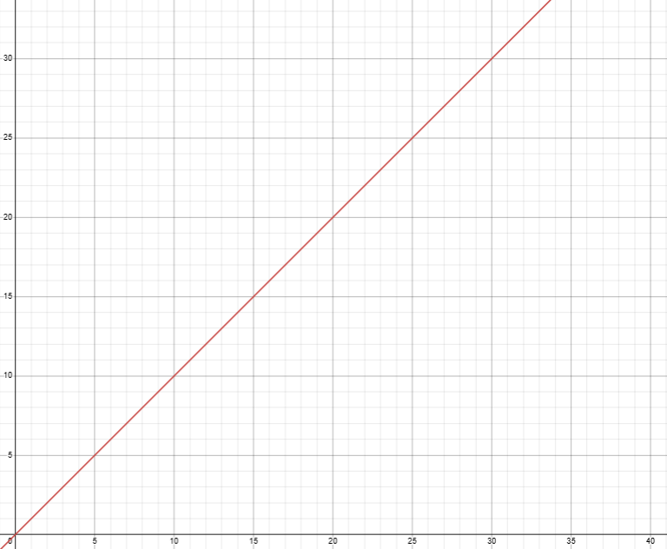
SQL Index
CustomerID | FirstName | LastName | Email | Age | Gender | City | MembershipStartDate
1 | John | Doe | john.doe@example.com | 34 | Male | Zurich | 2021-01-15
2 | Jane | Smith | jane.smith@example.com | 29 | Female | Geneva | 2020-05-22
3 | Michael | Brown | michael.brown@example.com | 45 | Male | Basel | 2019-11-30
4 | Emily | Davis | emily.davis@example.com | 27 | Female | Lausanne | 2018-04-10
5 | Daniel | Wilson | daniel.wilson@example.com | 32 | Male | Bern | 2022-03-12
6 | Laura | White | laura.white@example.com | 40 | Female | Lucerne | 2017-08-05
7 | James | Johnson | james.johnson@example.com | 36 | Male | Winterthur | 2023-06-18
8 | Emma | Martinez | emma.martinez@example.com | 30 | Female | Zurich | 2021-10-25
9 | David | Garcia | david.garcia@example.com | 48 | Male | Basel | 2019-02-28
10 | Olivia | Lopez | olivia.lopez@example.com | 26 | Female | Geneva | 2022-07-14
SELECT * FROM Customers WHERE FirstName LIKE ‘Laura’
Non-unique column: O(n)
Notes:
Firstname is niet unique, elke record moet doorlopen worden
Grafiek: relatie tussen aantal records en aantal checks.
Gaat rechtlijnig, elke record moet gechecked worden

Slide 61
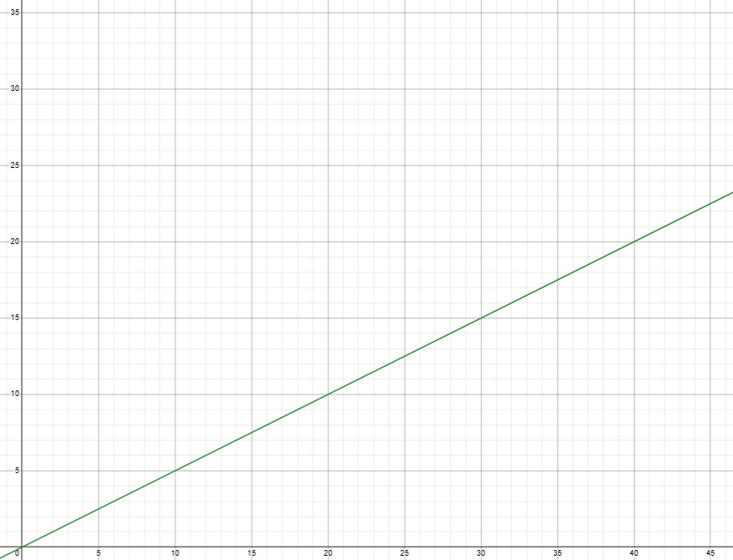
SQL Index
CustomerID | FirstName | LastName | Email | Age | Gender | City | MembershipStartDate
1 | John | Doe | john.doe@example.com | 34 | Male | Zurich | 2021-01-15
2 | Jane | Smith | jane.smith@example.com | 29 | Female | Geneva | 2020-05-22
3 | Michael | Brown | michael.brown@example.com | 45 | Male | Basel | 2019-11-30
4 | Emily | Davis | emily.davis@example.com | 27 | Female | Lausanne | 2018-04-10
5 | Daniel | Wilson | daniel.wilson@example.com | 32 | Male | Bern | 2022-03-12
6 | Laura | White | laura.white@example.com | 40 | Female | Lucerne | 2017-08-05
7 | James | Johnson | james.johnson@example.com | 36 | Male | Winterthur | 2023-06-18
8 | Emma | Martinez | emma.martinez@example.com | 30 | Female | Zurich | 2021-10-25
9 | David | Garcia | david.garcia@example.com | 48 | Male | Basel | 2019-02-28
10 | Olivia | Lopez | olivia.lopez@example.com | 26 | Female | Geneva | 2022-07-14
SELECT * FROM Customers WHERE Email LIKE ‘laura.white@example.com’
Unique column: O((n+1) / 2)
Notes:
email is unique, elke record moet doorlopen worden tot value gevonden word

Slide 62
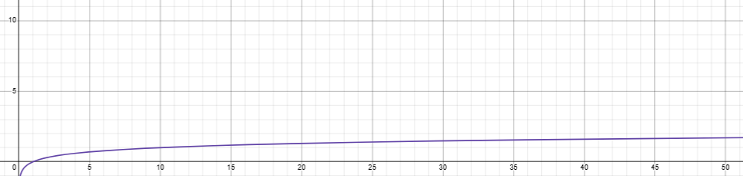
SQL Index
CustomerID | FirstName | LastName | Email | Age | Gender | City | MembershipStartDate
1 | John | Doe | john.doe@example.com | 34 | Male | Zurich | 2021-01-15
2 | Jane | Smith | jane.smith@example.com | 29 | Female | Geneva | 2020-05-22
3 | Michael | Brown | michael.brown@example.com | 45 | Male | Basel | 2019-11-30
4 | Emily | Davis | emily.davis@example.com | 27 | Female | Lausanne | 2018-04-10
5 | Daniel | Wilson | daniel.wilson@example.com | 32 | Male | Bern | 2022-03-12
6 | Laura | White | laura.white@example.com | 40 | Female | Lucerne | 2017-08-05
7 | James | Johnson | james.johnson@example.com | 36 | Male | Winterthur | 2023-06-18
8 | Emma | Martinez | emma.martinez@example.com | 30 | Female | Zurich | 2021-10-25
9 | David | Garcia | david.garcia@example.com | 48 | Male | Basel | 2019-02-28
10 | Olivia | Lopez | olivia.lopez@example.com | 26 | Female | Geneva | 2022-07-14
SELECT * FROM Customers WHERE CustomerID = 4
Primary Key: O(log(n))
Notes:
email is unique, elke record moet doorlopen worden tot value gevonden word

Slide 63
SQL Index
Indexed
CustomerID | FirstName | LastName | Email | Age | Gender | City | MembershipStartDate
1 | John | Doe | john.doe@example.com | 34 | Male | Zurich | 2021-01-15
2 | Jane | Smith | jane.smith@example.com | 29 | Female | Geneva | 2020-05-22
3 | Michael | Brown | michael.brown@example.com | 45 | Male | Basel | 2019-11-30
4 | Emily | Davis | emily.davis@example.com | 27 | Female | Lausanne | 2018-04-10
5 | Daniel | Wilson | daniel.wilson@example.com | 32 | Male | Bern | 2022-03-12
6 | Laura | White | laura.white@example.com | 40 | Female | Lucerne | 2017-08-05
7 | James | Johnson | james.johnson@example.com | 36 | Male | Winterthur | 2023-06-18
8 | Emma | Martinez | emma.martinez@example.com | 30 | Female | Zurich | 2021-10-25
9 | David | Garcia | david.garcia@example.com | 48 | Male | Basel | 2019-02-28
10 | Olivia | Lopez | olivia.lopez@example.com | 26 | Female | Geneva | 2022-07-14
SELECT * FROM Customers WHERE Email LIKE ‘laura.white@example.com’
Notes:
Index op email

Slide 64
SQL Index – B-Tree
Key:
james.johnson@example.com
Value:
8
Key:
Emily.davis@example.com
Value:
5
Key:
John.doe@example.com
Value:
1
Key:
Michael.brown@example.com
Value:
1
Key: Daniel.wilson@example.com
Value:
1
Key:
David.garcia@example.com
Value:
9
Key:
emma.martinez@example.com
Value:
1
Key:
jane.smith@example.com
Value:
1
Key:
Laura.white@example.com
Value:
6
SELECT * FROM Customers WHERE Email LIKE ‘laura.white@example.com’

Slide 65
SQL Index – B-Tree
Key:
james.johnson@example.com
Value:
8
Key:
Emily.davis@example.com
Value:
5
Key:
John.doe@example.com
Value:
1
Key:
Michael.brown@example.com
Value:
1
Key: Daniel.wilson@example.com
Value:
1
Key:
David.garcia@example.com
Value:
9
Key:
emma.martinez@example.com
Value:
1
Key:
jane.smith@example.com
Value:
1
Key:
Laura.white@example.com
Value:
6
SELECT * FROM Customers WHERE Email LIKE ‘laura.white@example.com’
Notes:
Gestructureerd datatype. “gesorteerd == balanced”
Dankzij balanced kan er een path gekozen worden naar gezochte value

Slide 66
SQL Index
Pros | Cons
Improved Query Performance: Faster data retrieval due to reduced search time. | Increased Storage Space: Indexes require additional disk space.
Faster Sorting: Enhanced performance of ORDER BY and GROUP BY clauses. | Slower Write Operations: Insert, update, and delete operations can be slower due to index maintenance.
Efficient Data Access: Accelerates queries involving JOIN, WHERE, and SELECT clauses. | Index Maintenance: Requires regular updates to maintain optimal performance.
Reduced Disk I/O: Fewer disk reads needed for query execution. | Overhead on Transactions: Can affect the speed of transaction processing.
Enhanced Data Integrity: Supports enforcement of unique constraints. | Complex Management: Requires careful planning and management for optimal use.

Slide 67
Opentelemetry

Slide 68
Opentelemetry (Otel)
Observability framework and toolkit
What is Observability?
Traces
Metrics
Logs
Vendor-agnostic
Single set of APIs and conventions
Notes:
Observability is the ability to understand the internal state of a system by examining its outputs

Slide 69
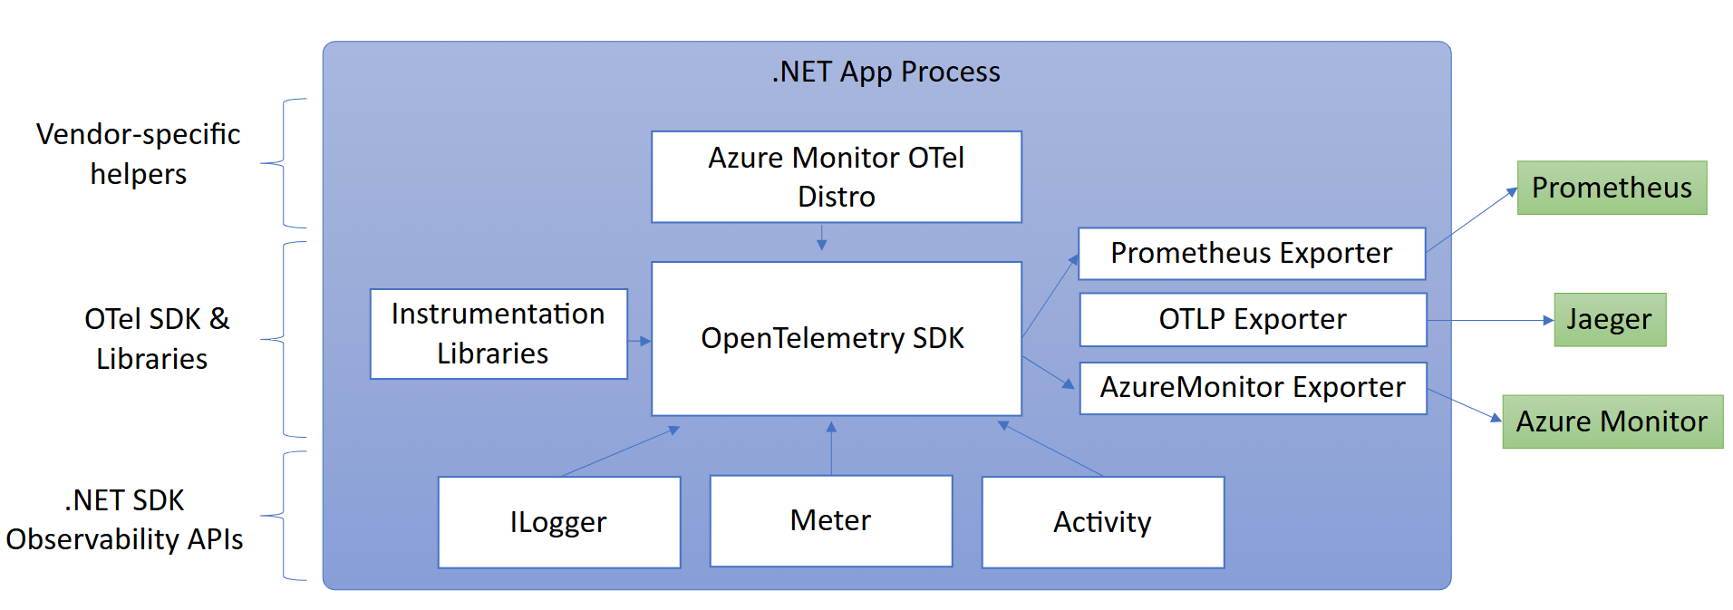
OTel in .NET
https://learn.microsoft.com/en-us/dotnet/core/diagnostics/observability-with-otel

Slide 70
Otel Demo

Slide 71
Missed your topics?
Slidedeck and demos are on my GitHub https://github.com/NicoVermeir/DotnetAbc
Come talk to me in the hallway or on BlueSky! @NicoVermeir.bsky.social

